Slide 1




Slide 2
Building a Review-Based QA System
Notes:
Hello and welcome, in this video we will start to dive into the components of the internal structure of transformers.

Slide 3

Introduction
Problem: Products can have hundreds to thousands of reviews, so it can be a major drag to find one that is relevant.
Solution:
Post your question on the community QA platforms provided by websites like Amazon.
Get an immediate answer using transformers.
Can I use this camera at night?
Does this guitar come with a strap?

Slide 4
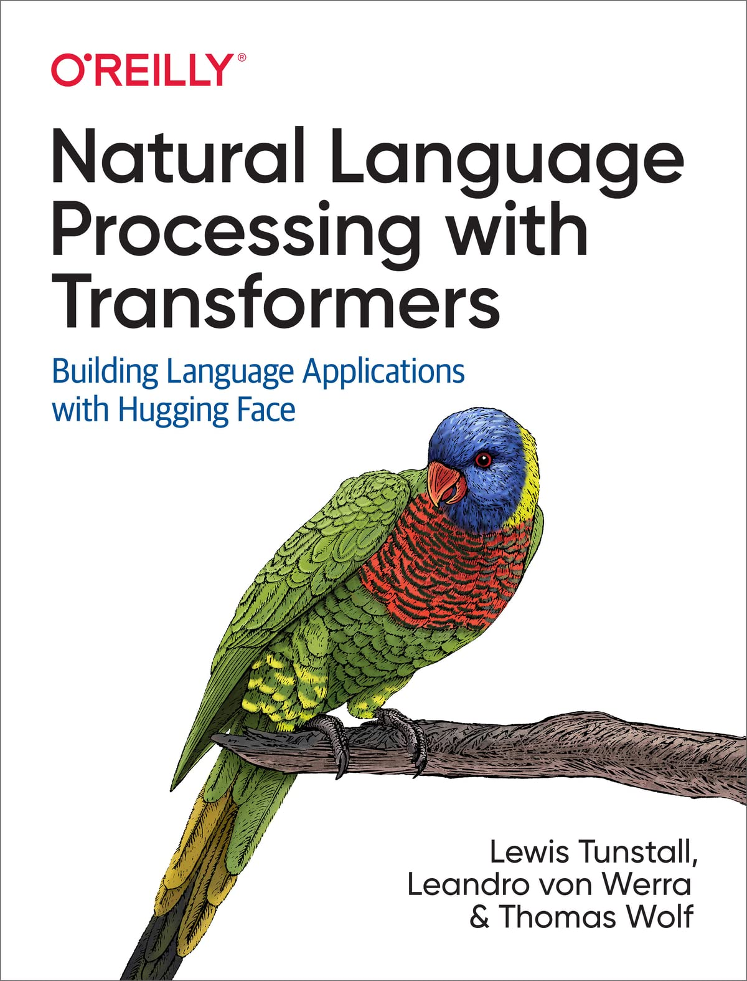
This example is taken from Natural language processing with transformers book.

Slide 5
The Dataset
The SubjQA2 dataset which consists of more than 10,000 customer reviews in English about products and services in six domains:
Trip‐Advisor
Restaurants
Movies
Books
Electronics
Grocery
Each review is associated with a question that can be answered using one or more sentences from the review.
As we’ll soon see, there are also unanswerable questions that are designed to produce more robust models.
The interesting aspect of this dataset is that most of the questions and answers are subjective; that is, they depend on the personal experience of the users.

Slide 6
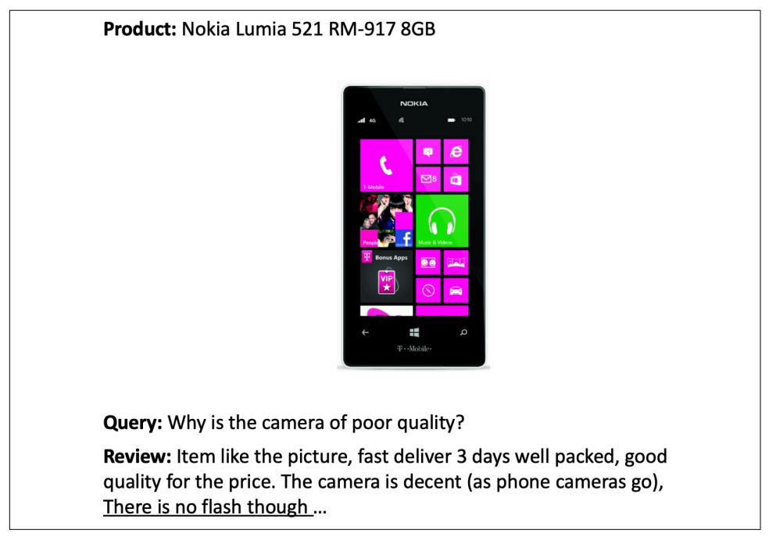
The Dataset Example
Means it cannot be answered with shortcuts like keyword search or paraphrasing the input question.
These features make SubjQA a realistic dataset to benchmark our review-based QA models on, since user-generated content like this resembles what we might encounter in the wild.

Slide 7
Loading SubjQA dataset
Download the dataset from the Hugging Face Hub and to find out which subsets.
For our use case, we’ll focus on building a QA system for the Electronics domain.
SubjQA stores the answers to each question as a nested dictionary.
from datasets import get_dataset_config_names
domains = get_dataset_config_names("subjqa")
domains
['books', 'electronics', 'grocery', 'movies', 'restaurants', 'tripadvisor']
from datasets import load_dataset
subjqa = load_dataset("subjqa" , name="electronics")
print(subjqa["train" ]["answers" ][1])
{ 'text' : ['Bass is weak as expected', 'Bass is weak as expected, even with EQ adjusted up'], 'answer_start' : [1302, 1302], 'answer_subj_level' : [1, 1], 'ans_subj_score' : [0.5083333253860474, 0.5083333253860474], 'is_ans_subjective' : [True, True]}

Slide 8
Data exploration
Flatten the nested columns
Notice that the dataset is relatively small, with only 1,908 examples in total. This simulates a real-world scenario, since getting domain experts to label extractive QA datasets is labor-intensive and expensive.
import pandas as pd
dfs = {split: dset.to_pandas() for split, dset in subjqa.flatten(). items()}
for split, df in dfs.items():
print(f"Number of questions in {split}: {df['id'].nunique()}" )
Number of questions in train: 1295
Number of questions in test: 358
Number of questions in validation: 255

Slide 9
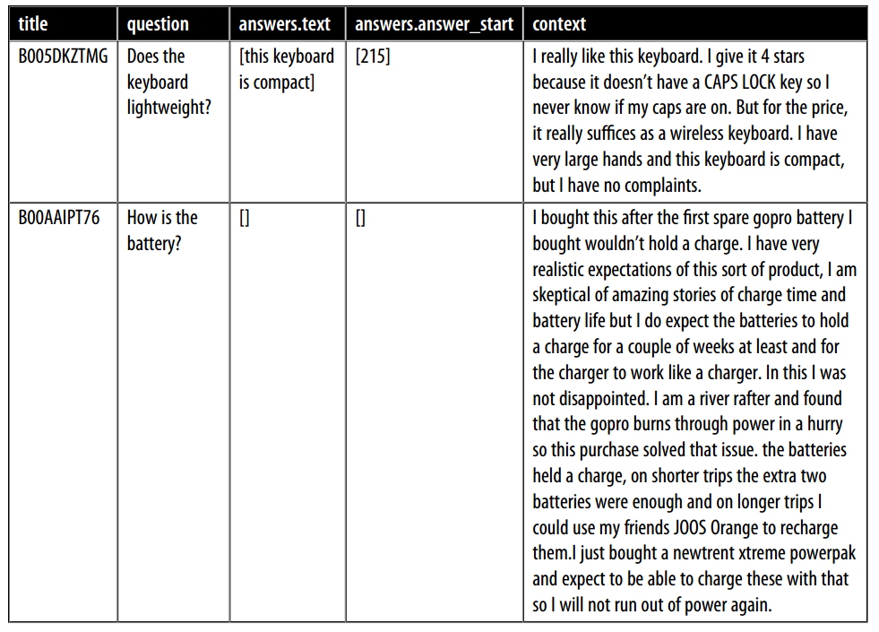
Sample of Data
Columns in the SubjQA dataset:
Title : that represent The Amazon Standard Identication Number associated with each product.
question : That represent query.
answers dot answer text : represent the span of text in the review labeled by the annotator.
answers dot answer_start: That indicate the start character index of the answer span.and context column which represent the customer review .
qa_cols = ["title" , "question" , "answers.text" ,"answers.answer_start" , "context" ]
sample_df = dfs["train" ][qa_cols].sample(2, random_state=7)

Slide 10
Extracting Answers from Text
Needing for our QA system is to find a way to identify a potential answer as a span of text in a customer review.
For example:
Question: “Is it waterproof?”
Passage: “This watch is waterproof at 30m depth”.
Output: “waterproof at 30m”.
Needing to understand how to:
Frame the supervised learning problem.
Tokenize and encode text for QA tasks.
Deal with long passages that exceed a model’s maximum context size.

Slide 11
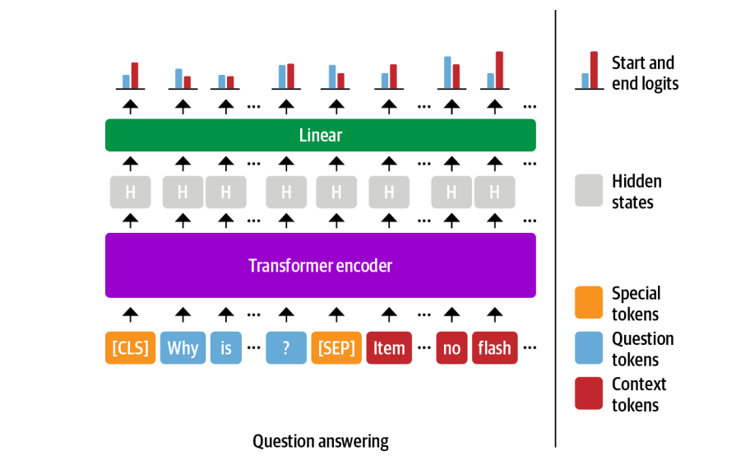
Span classification
Span classification task: The most common way to extract answers from text is by framing the problem.
where the start and end tokens of an answer span act as the labels that a model needs to predict.
Since our training set is relatively small, with only 1,295 examples, a good strategy is to start with a language model that has already been fine-tuned on a large-scale QA dataset like SQuAD.
In general, these models have strong reading comprehension capabilities and serve as a good baseline upon which to build a more accurate system.

Slide 12
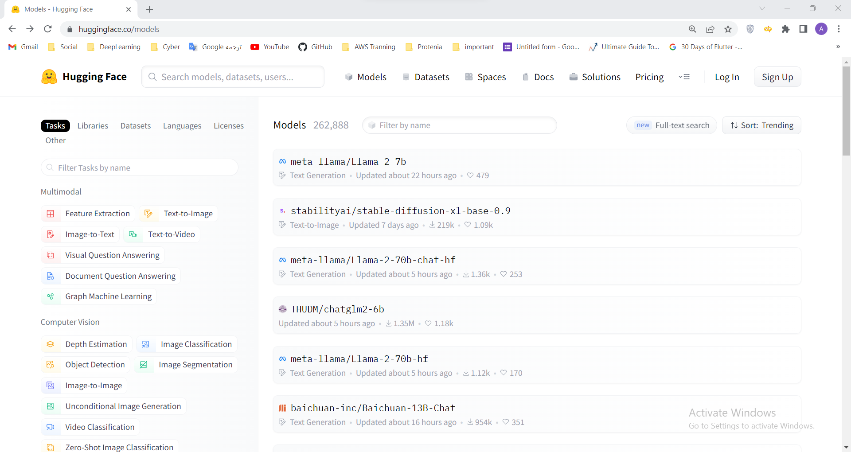
Fine-tunning Extractive QA

Slide 13
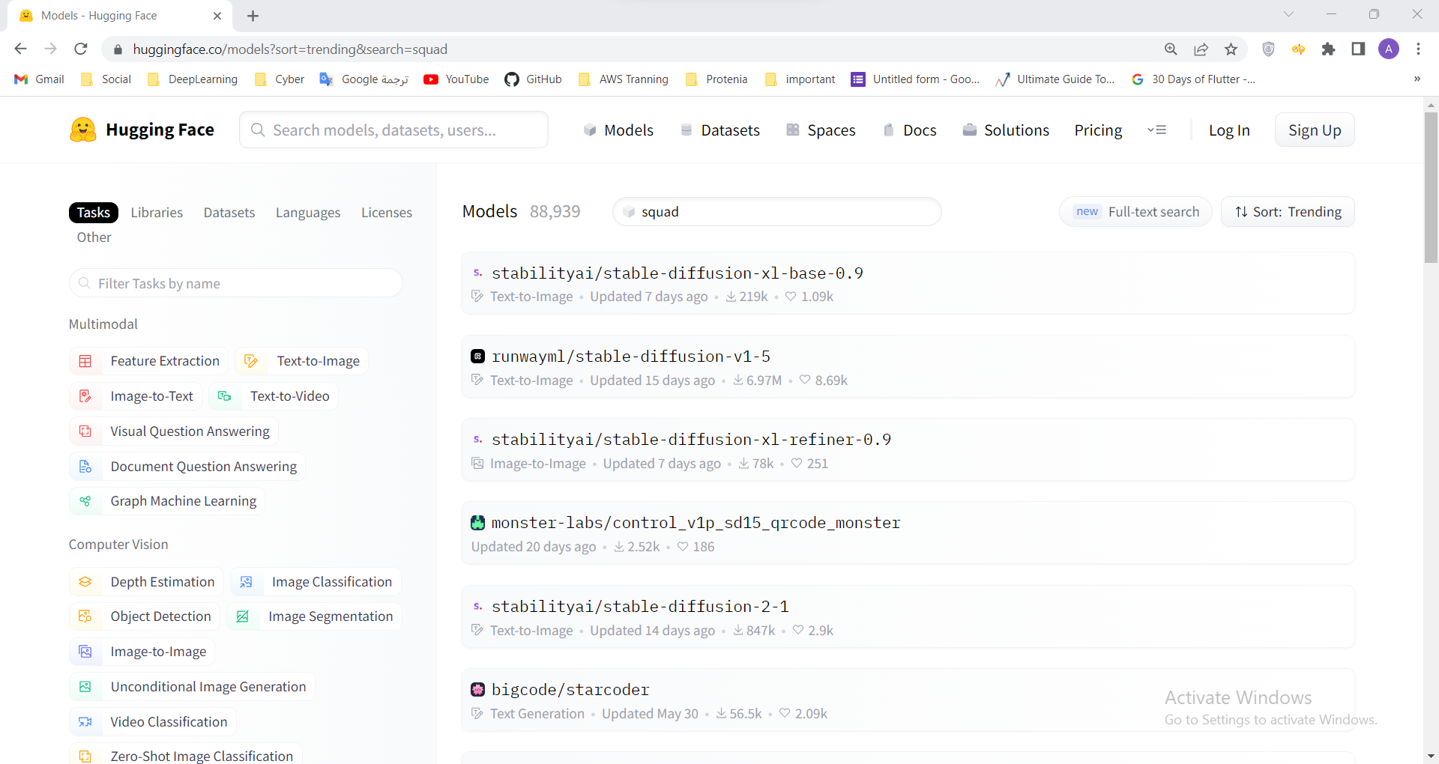
Fine-tunning Extractive QA

Slide 14
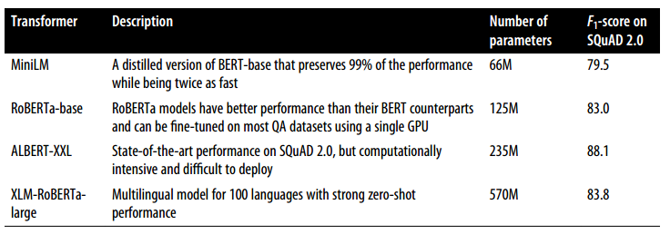
Fine-tunning Extractive QA
In general, the answer depends on various factors like whether your corpus is mono- or multilingual and the constraints of running the model in a production environment.
MiniLM model since it is fast to train and will allow us to quickly iterate on the techniques that we’ll be exploring.

Slide 15
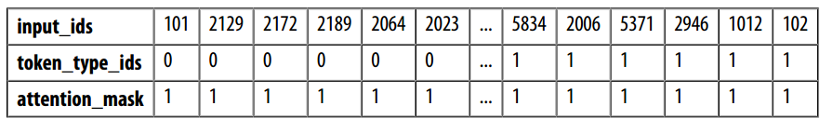
Tokenizing text for QA
Tokenizer to encode our texts.
loading the MiniLM model checkpoint from the Hugging Face Hub:
Extracting an answer from a short passage of text:
In extractive QA tasks, the inputs are provided as (question, context) pairs
input_ids: that represent a unique numerical identifier for each token.
attention_mask: allows the model to ignore the padded parts of the input.
token_type_ids: tensor indicates which part of the inputs corresponds to the question and context. (a 0 indicates a question token, a 1 indicates a context token).
from transformers import AutoTokenizer
model_ckpt = "deepset/minilm-uncased-squad2"
tokenizer = AutoTokenizer. from_pretrained(model_ckpt)
question = "How much music can this hold?"
context = "An MP3 is about 1 MB/minute, so about 6000 hours depending on file size."
inputs = tokenizer(question, context, return_tensors="pt" )

Slide 16
Tokenizing text for QA
To understand how the tokenizer formats the inputs for QA tasks, let’s decode the input_ids tensor:
print(tokenizer. decode(inputs["input_ids" ][0]))
[CLS] how much music can this hold? [SEP] an mp3 is about 1 mb / minute, so about 6000 hours depending on file size. [SEP]
[CLS] question tokens [SEP] context tokens [SEP]

Slide 17

Tokenizing text for QA
Instantiate the model with a QA head and run the inputs through the forward pass:
linear layer that takes the hidden states from the encoder and
computes the logits for the start and end spans.
This means that we treat QA as a form of token classification.
import torch
from transformers import AutoModelForQuestionAnswering
model = AutoModelForQuestionAnswering. from_pretrained(model_ckpt)
with torch. no_grad():
outputs = model(**inputs)
print(outputs)
QuestionAnsweringModelOutput(loss=None, start_logits=tensor([[-0.9862, -4.7750, -5.4025, -5.2378, -5.2863, -5.5117, -4.9819, -6.1880, -0.9862, 0.2596, -0.2144, -1.7136, 3.7806, 4.8561, -1.0546, -3.9097, -1.7374, -4.5944, -1.4278, 3.9949, 5.0390, - 0.2018, -3.0193, -4.8549, -2.3107, -3.5110, -3.5713, -0.9862]]), end_logits=tensor([[-0.9623, -5.4733, -5.0326, -5.1639, -5.4278, -5.5151, -5.1749, -4.6233, -0.9623, -3.7855, -0.8715, -3.7745, -3.0161, -1.1780, 0.1758, -2.7365, 4.8934, 0.3046, -3.1761, -3.2762, 0.8937, 5.6606, -0.3623, -4.9554, -3.2531, -0.0914, 1.6211, -0.9623]]), hidden_states=None, attentions=None )

Slide 18
Tokenizing text for QA
To convert the outputs into an answer span, we first need to get the logits for the start and end tokens:
If we compare the shapes of these logits to the input IDs they should return same size
start_logits = outputs.start_logits
end_logits = outputs.end_logits
print(f"Input IDs shape: {inputs.input_ids.size()}")
print(f"Start logits shape: {start_logits.size()}")
print(f"End logits shape: {end_logits.size()}")
Input IDs shape: torch.Size([1, 28]) Start logits shape: torch.Size([1, 28]) End logits shape: torch.Size([1, 28])

Slide 19
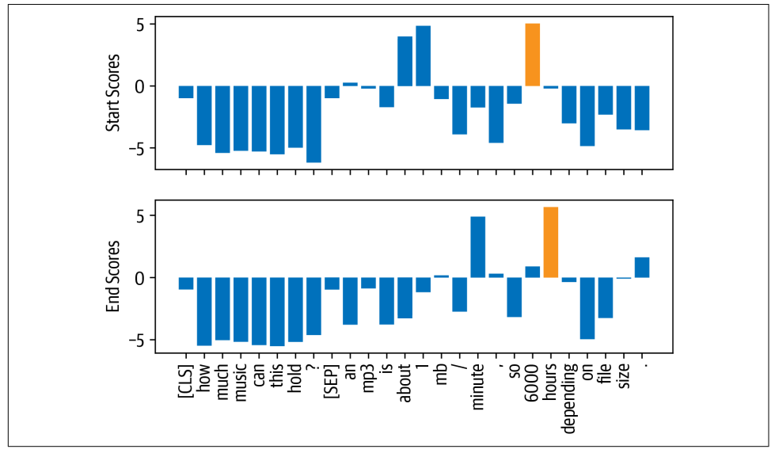
Tokenizing text for QA
There are two logits (a start and end) associated with each input token.
larger and positive logits correspond to more likely candidates for the start and end tokens.
In this example:
The model assigns the highest start token logits to the numbers “1” and “6000”, which makes sense since our question is asking about a quantity.
The end tokens with the highest logits are “minute” and “hours”.

Slide 20
Tokenizing text for QA
To get the final answer:
Computing the argmax over the start and end token logits.
Slice the span from the inputs.
Decodes the result so we can get the resulting text:
import torch
start_idx = torch. argmax(start_logits)
end_idx = torch. argmax(end_logits) + 1
answer_span = inputs["input_ids" ][0][start_idx: end_idx]
answer = tokenizer. decode(answer_span)
print(f"Question: {question}" )
print(f"Answer: {answer}" )
Question: How much music can this hold? Answer: 6000 hours

Slide 21
Pipeline Function
In Transformers, all of these preprocessing and postprocessing steps are conveniently wrapped in a dedicated pipeline.
We can instantiate the pipeline by passing our tokenizer and fine-tuned model :
In addition to the answer, the pipeline also returns the model’s probability estimate in the score field (obtained by taking a SoftMax over the logits).
This is handy when we want to compare multiple answers within a single context.
The model predict multiple answers by specifying the topk parameter.
it is possible to have questions for which no answer is possible.
In these cases, the model will assign a high start and end score to the [CLS] token, and the pipeline maps this output to an empty string:
from transformers import pipeline
pipe = pipeline("question-answering" , model=model, tokenizer=tokenizer)
pipe(question=question, context=context, topk=3)
[{'score': 0.26516005396842957,'start': 38,'end': 48,'answer': '6000 hours'}, {'score': 0.2208300083875656,'start': 16,'end': 48,'answer': '1 MB/minute, so about 6000 hours'}, {'score': 0.10253632068634033,'start': 16,'end': 27,'answer': '1 MB/minute'}]
pipe(question="Why is there no data?" , context=context, handle_impossible_answer=True)
{'score': 0.9068416357040405, 'start': 0, 'end': 0, 'answer': ''}

Slide 22
What if the context often contains more tokens than the maximum sequence length of the model?

Slide 23
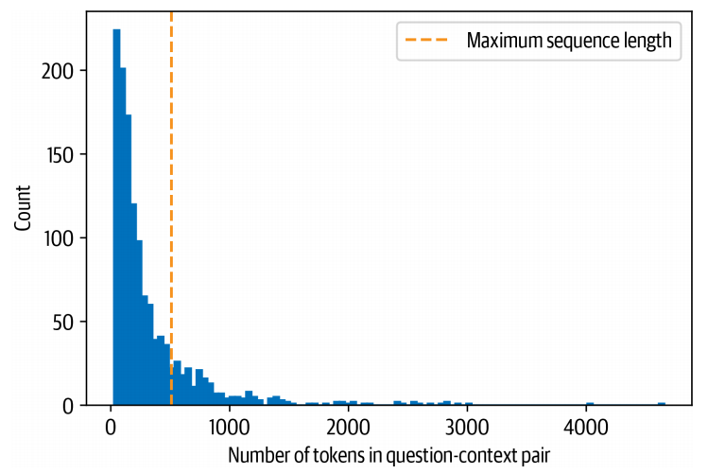
Dealing with long passages
For example:
The SubjQA training set contains question-context pairs that won’t fit within MiniLM’s context size of 512 tokens.
For text classification:
Truncating long texts under the assumption that enough information was contained in the embedding of the [CLS] token to generate accurate predictions.
Item like the picture, fast deliver 3 days well packed, good quality for the price. The camera is decent (as phone cameras go). There is no flash though...

Slide 24
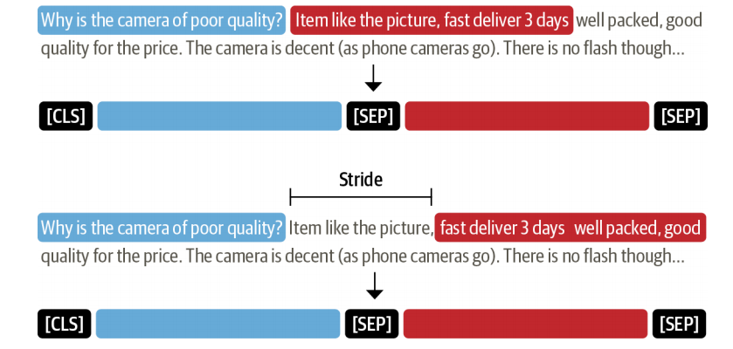
Dealing with long passages
For QA:
Problem: the answer to a question could lie near the end of the context and thus would be removed by truncation.
Solution: apply a sliding window across the inputs, where each window contains a passage of tokens that fit in the model’s context.

Slide 25
Dealing with long passages
set in the tokenizer to enable the sliding window.
The size of the sliding window is controlled by the max_length argument, and the size of the stride is controlled by stride.
Example from the training set and define a small window to illustrate how this works:
return_overflowing_tokens=True
example = dfs["train" ] . iloc[0][["question" , "context" ]]
tokenized_example = tokenizer( example["question" ],
example["context" ],
return_overflowing_tokens=True,
max_length=100,
stride=25)

Slide 26
Dealing with long passages
In this case get a list of input_ids, one for each window.
Check the number of tokens we have in each window:
we can see where two windows overlap by decoding the inputs:
for idx, window in enumerate(tokenized_example["input_ids" ]):
print(f"Window #{idx} has {len(window)} tokens" )
for window in tokenized_example["input_ids" ]:
print(f"{tokenizer.decode(window)} \n" )
[CLS] how is the bass? [SEP] i have had koss headphones in the past, pro 4aa and qz - 99. the koss portapro is portable and has great bass response. the work great with my android phone and can be " rolled up " to be carried in my motorcycle jacket or computer bag without getting crunched. they are very light and don't feel heavy or bear down on your ears even after listening to music with them on all day. the sound is [SEP]
[CLS] how is the bass? [SEP] and don't feel heavy or bear down on your ears even after listening to music with them on all day. the sound is night and day better than any ear - bud could be and are almost as good as the pro 4aa. they are " open air " headphones so you cannot match the bass to the sealed types, but it comes close. for $ 32, you cannot go wrong. [SEP]

Slide 27
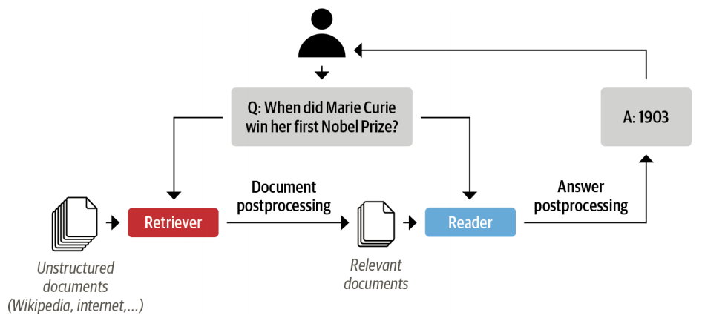
Summary
Having some intuition about how QA models can extract answers from text.
Using a pretrained QA model and passing the question along with the context .
Problem:
system’s users will only provide a question about a product. so, we need some way of selecting relevant passages from among all the reviews in our corpus.
Solution:
concatenate all the reviews of a given product together and feed them to the model as a single, long context.
The drawback of this approach: the context can become extremely long and thereby introduce an unacceptable latency for our users’ queries.
To handle this, modern QA systems are typically based on the retriever-reader architecture.
SubjQA dataset
the Electronics domain.

